Slide 1

Revision
Notes:
Discuss mocks/GCSE BTEC exams – timing, linear exams, don’t panic, but take them seriously!

Slide 2

https://www.youtube.com/watch?v=MdlLdQHvsv0
Notes:
Get students to identify the good and bad revision habits: good = working in a well lit quiet room (similar to the recall environment of an exam hall), having a revision schedule/plan. Bad = revising the wrong subject (discuss study buddies who do the same subject rather than getting your mates to test you) Cramming and lack of sleep – ‘is this a word?’ …. (more discussion later), Just reading (only recall 20%). Energy drinks (discuss same ‘state’ for recall – no energy drinks in exam hall.

Slide 3

Beating exam stress
In pairs, think back to the session we had on stress. What are your key exam stressors?
Agree on 3 techniques you are going to try to help you cope with exam stress
Feedback to the rest of your table and agree on 3 techniques
Feedback to the rest of the class

Slide 4
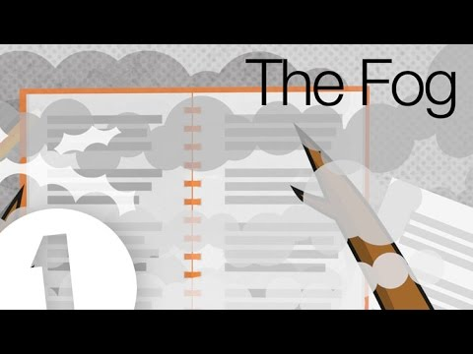
Improve your memory
https://www.youtube.com/watch?v=I5HDfBubAjI
Notes:
Ref we will be looking at learning styles in a bit

Slide 5
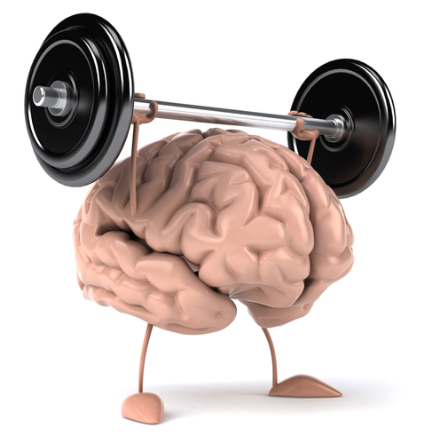
Improve your memory
Revising is all about memory.
The memory is like a muscle. If you don’t exercise it, it will grow weaker, but if you do exercise it, it will get stronger and stronger.

Slide 6
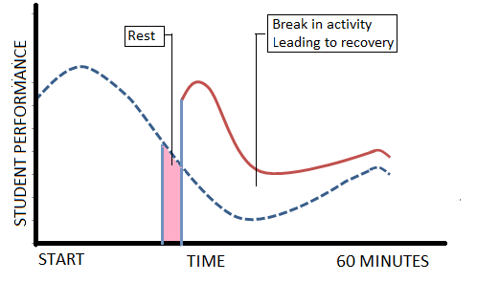
Improve your memory
Take lots of short breaks. Most people can only concentrate, understand and remember for between 20 and 45 minutes at a time.
Do not revise for longer without a break. If you do, you will not remember most of what you did.
Notes:
Remind them that a break should be a change in task (not a massive nap) – go on to discuss power hour- 20 minutes revision, 20 minutes test, 10 minutes marking

Slide 7
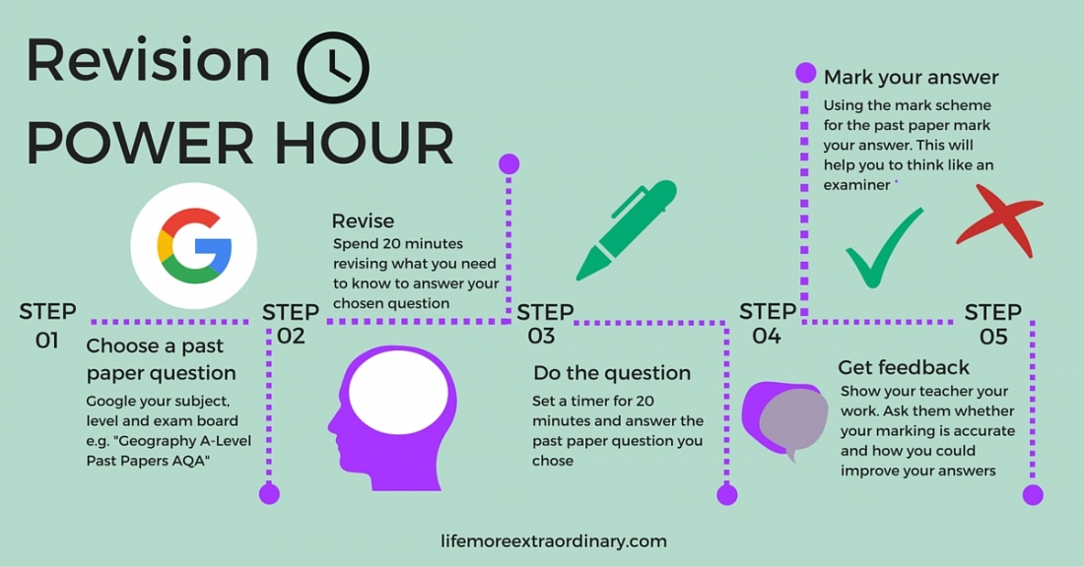
Notes:
Explain that there is no point doing a small mark question then checking the mark scheme, doing another, checking the mark scheme etc – needs to be a good section of the paper (20 minutes), no notes

Slide 8

Improve your memory
Once you have finished learning something, your brain actually increases its power and carries on remembering.
It will be sorting out what it has been learning, creating a more complete picture of everything it has just learnt.
Notes:
Could discuss STM/LTM importance of sleep

Slide 9

Improve your memory
What type of learner are you?
Tick the statements which best describe you, your actions and the things that you say.
Notes:
See booklet for statments

Slide 10



Improve your memory
I ticked the following statements:
1, 4, 7, 10, 13, 16, 19, 22, 25, 28, 31, 34, 37
I ticked the following statements:
2, 5, 8, 11, 14, 17, 20, 23, 26, 29, 32, 35, 38
I ticked the following statements:
1, 4, 7, 10, 13, 16, 19, 22, 25, 28, 31, 34, 37

Slide 11
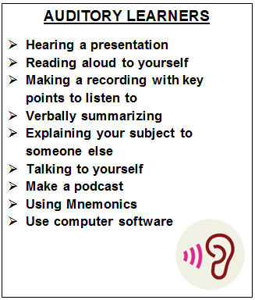
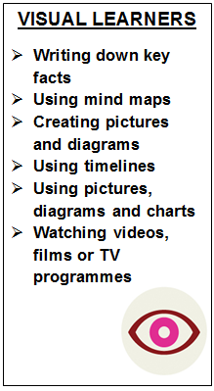
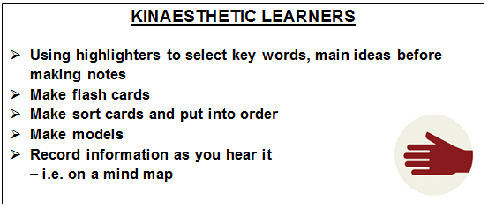
Improve your memory
Revision techniques for different learners
Notes:
Trial and error – mix it up. Find what works best for you. Remember though, they must keep testing themselves – flash cards alone wont work

Slide 12
Improve your memory
Good revision techniques for different learners
In pairs, discuss which revision techniques you already use
Which new ones would you like to try?
Notes:
Definition of insanity: doing the same thing over and over and expecting a different result. If you worked hard for tests in the past and didn’t get good grades, try a different revision strategy.

Slide 13
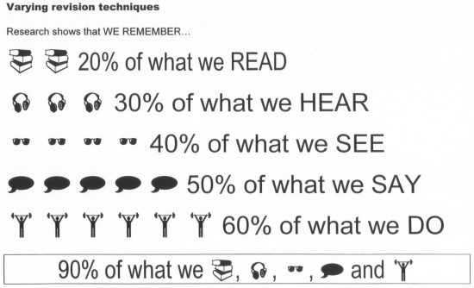
Improve your memory
Notes:
Anyone who says they learn best by reading the revision guide is mistaken!

Slide 14
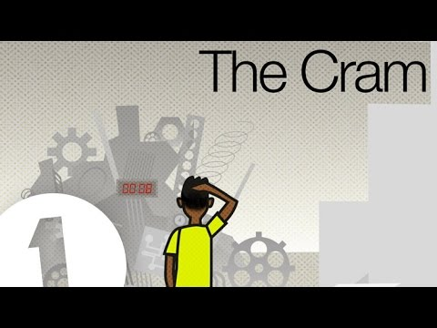
Stop cramming
https://www.youtube.com/watch?v=VpWXhER-yEw

Slide 15
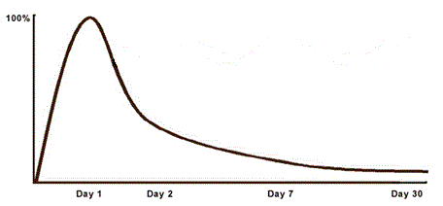
Stop cramming
The Curve of Forgetting
Day 1: At the end of a lesson, you know 100% of what you understood (the highest point of the curve).
Day 2: You will have lost 50%-80% of what you learned. In fact, up to 56% of new information can be lost in the first hour after learning it.
Day 7: One week after the lesson, you remember less than 25% of what was learned in the lesson.
Day 30: One month later, you remember 2%-3% of the original lesson.
Notes:
You need to keep revisiting. (flash cards are good for this – making them isn’t enough)

Slide 16
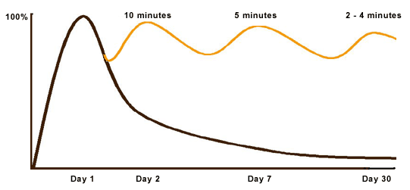
Stop cramming
Halting the loss of memory decay
Day 2: If you spend 15 – 20 minutes reviewing the information (revision, rewriting your notes or related reading) within 24 hours of learning it, you can increase your recall of it to almost 100% again.
Day 7: Another review of the information for only 10 minutes will "reactivate" the same material.
Day 30: Your brain will only need 4 - 8 minutes to re-access the learned material.
Notes:
We discussed this at induction, but not many people actually do it. You need to be revisiting new content along side revising for end of year mocks etc. Next year will be the same.

Slide 17
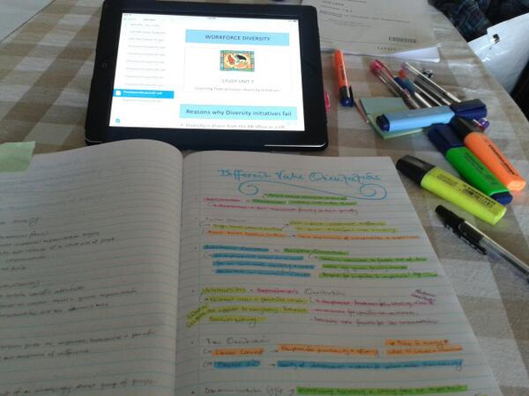
Stop cramming
It is recommended that each night, you spend 15 – 20 minutes per subject reviewing what you learned that day.
Once a week, spend 30 – 60 minutes per subject revising your lessons and text book notes for the past week.
Finally, once a month spend 30 - 60 minutes per subject reviewing all the notes you’ve taken to that point.

Slide 18
Stop cramming
Read the advice on Revision Timetables.
Design a revision timetable for your subjects.
You can use the Planning Your Revision…
… or try out some apps to help you get organised!
Notes:
Do it now or it will be too late.

