Slide 1


British Values
& Prevent

Slide 2
Quick quiz
https://www.surveymonkey.co.uk/r/knifecrimesurvey

Slide 3

British Values & Prevent
https://www.youtube.com/watch?v=GHcuaV3qRlA
What does the song make you think of?
Does it mean the same to people now as it did in the 1940’s? Why?
What do you think Britain stands for today?
Notes:
Think, pair and share – give small groups or pairs time to consider the questions in silence, then share with the wider group.

Slide 4
Quick task
What are the five British Values?
What are some of the British values you would consider?

Slide 5

The five British Values
Democracy
The rule of law
Individual liberty
Mutual respect
Tolerance
Quick reminder these are on the back of your lanyard!

Slide 6
Quick Task
Find a definition for the five British Values, writing them on the handout provided.

Slide 7
Democracy
Britain is a democracy – this means that the people in Britain vote for the people who make the laws and decide how the country is run. If we didn’t have a democracy, just one person might be able to make all the laws and that would not be fair.

Slide 8
The rule of the law
In Britain we have a police force who make sure people do not do the wrong thing and break the law – this means that we are safe.

Slide 9
Individual Liberty
In Britain, as long as we do not break the law, we can live as we choose to and have our own opinions about things.

Slide 10
Mutual Respect
We might not always agree with other people, but we try to show respect for their thoughts and feelings.
We can give respect to others and we can expect other people to show us respect.

Slide 11
Tolerance
In Britain we accept that other people might have different beliefs than ours and they may believe in different religions.

Slide 12






Which of these do you know and use?

Slide 13

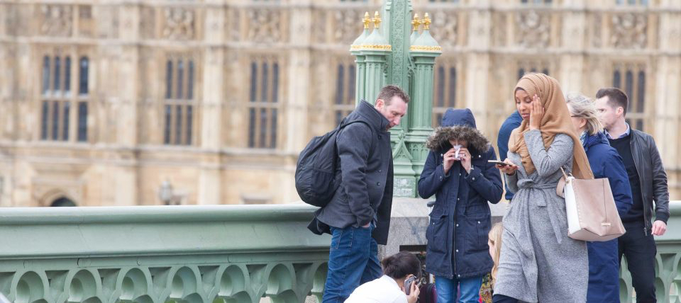
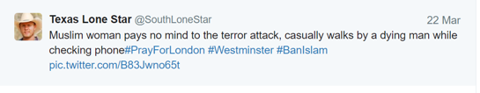
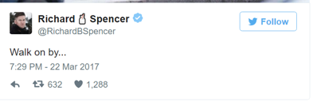
What message do the media really give?
Image shared by a lot of right wing groups after the Westminster attack. Britain First are just one eg of these groups. They are up to 1.7 million like and shares on Facebook, therefore when they post something like this it’s seen by a huge number of people.

Slide 14
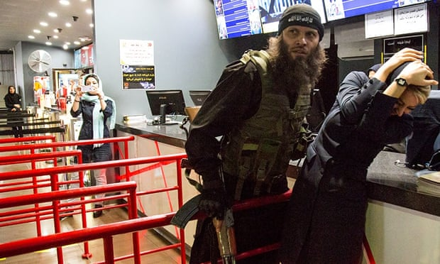
Notes:
the slide ‘Faking it on the internet’ was presented as being a real attack on the internet – but is actually a TV show being filmed. I showed this to the students last week – but you could show it again to see if they remembered!

Slide 15
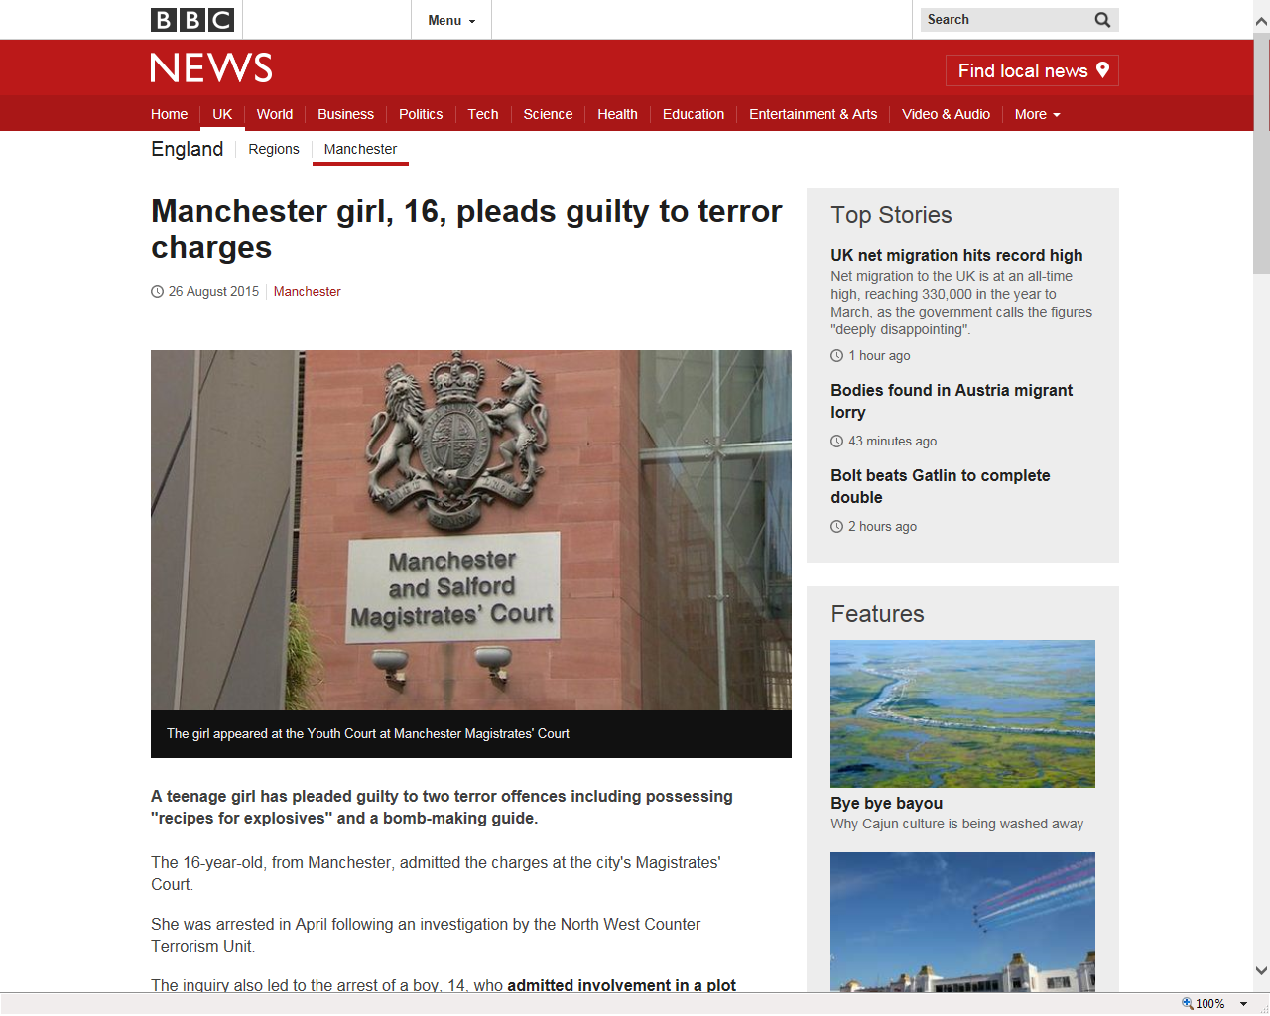
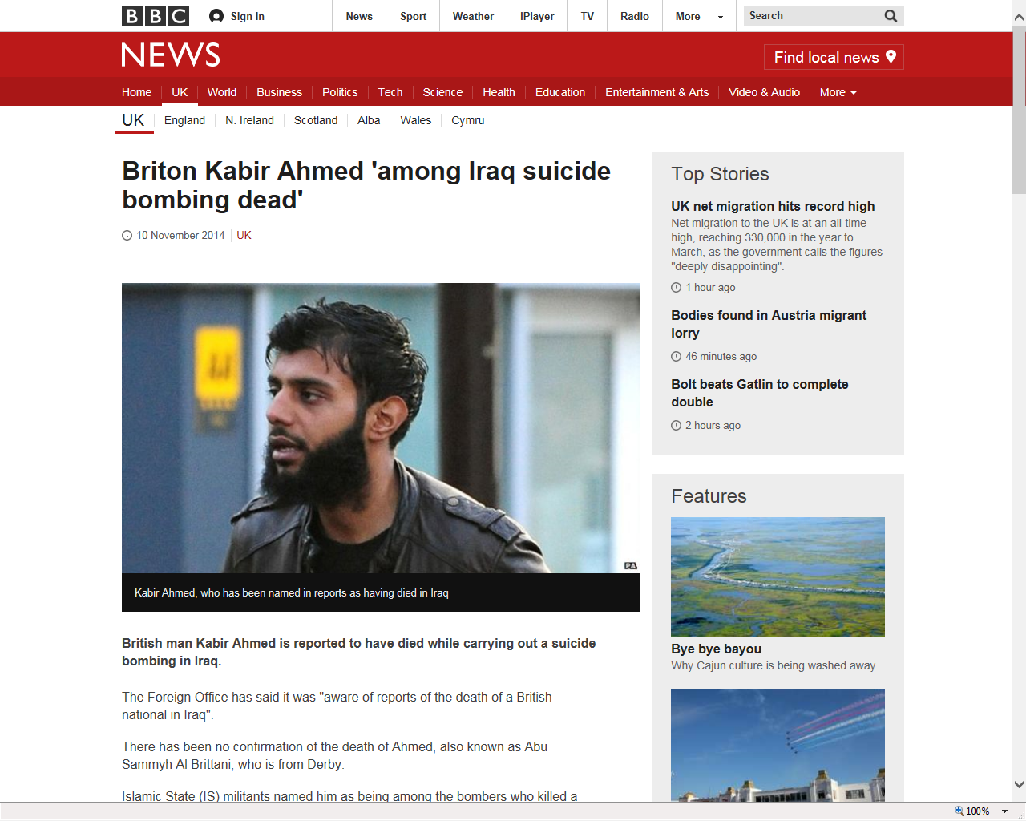
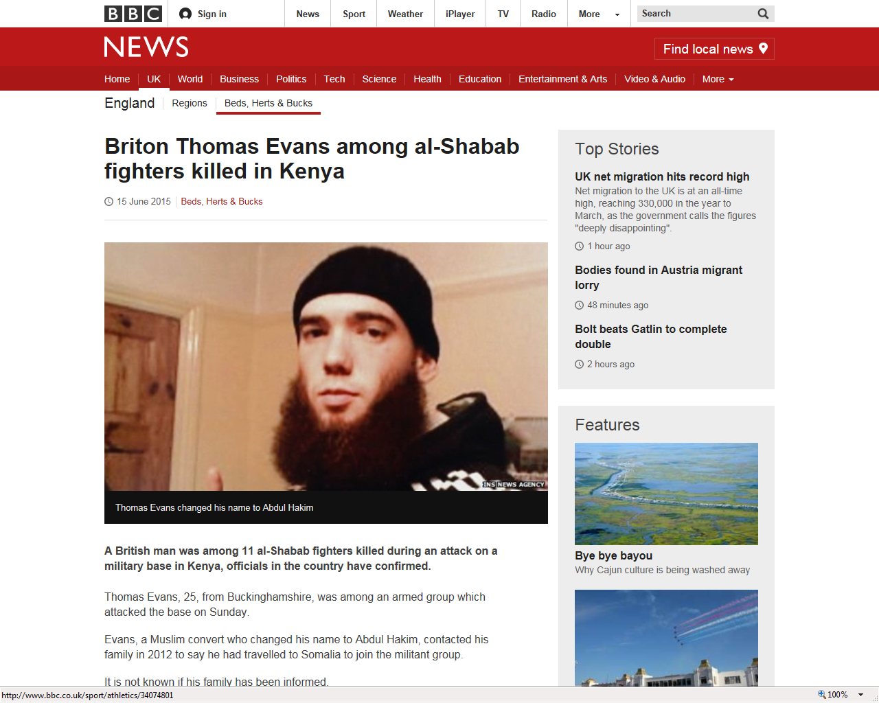
What are we trying to prevent:

Slide 16

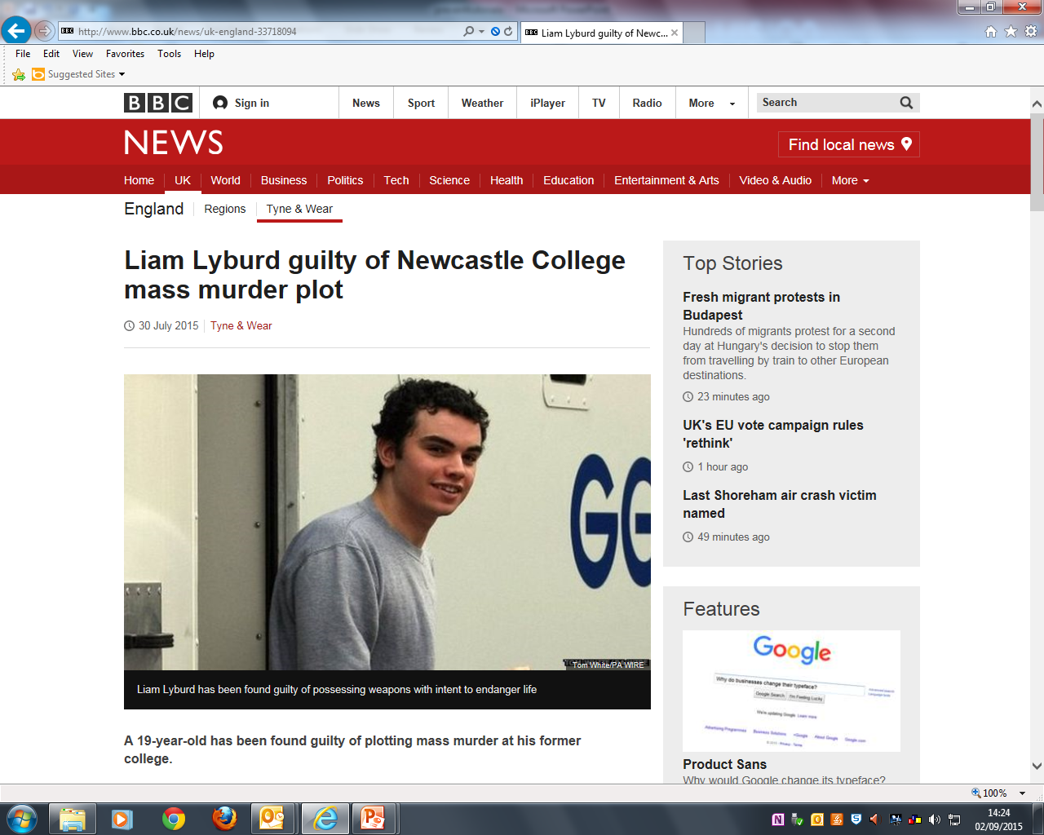
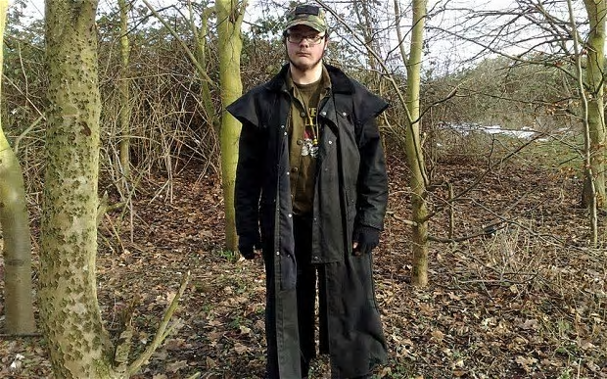
Neo-Nazi sixth former 'plotted new Columbine massacre in Loughborough'
Michael Piggin, 18, compiled a list of six potential targets including his school in Loughborough and the town's university, council offices, mosque and cinema

Slide 17







Right Wing:
Notes:
Britain First (a far right group) now has more than one million followers on Facebook
National Action is a proscribed (banned) group. It was banned under the Terrorism Act in 2016 and it is a criminal offence to be affiliated or connected to it in any way, or to have any of their literature. They have been distributing leaflets at Leicester Uni and 5 arrests were made last Wednesday (slide 11)

Slide 18
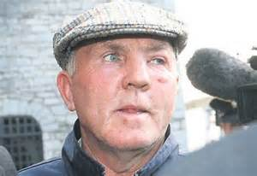
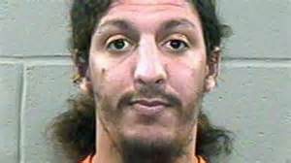

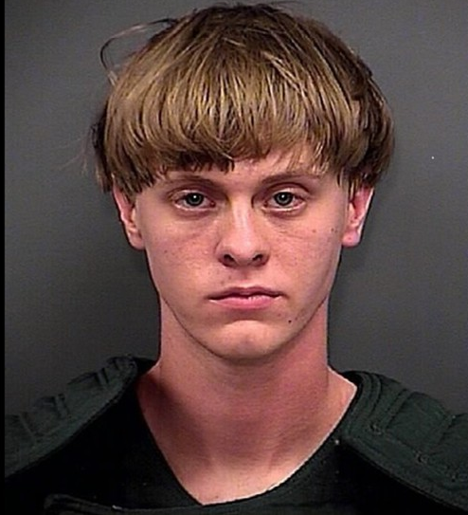
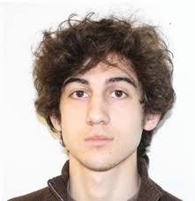
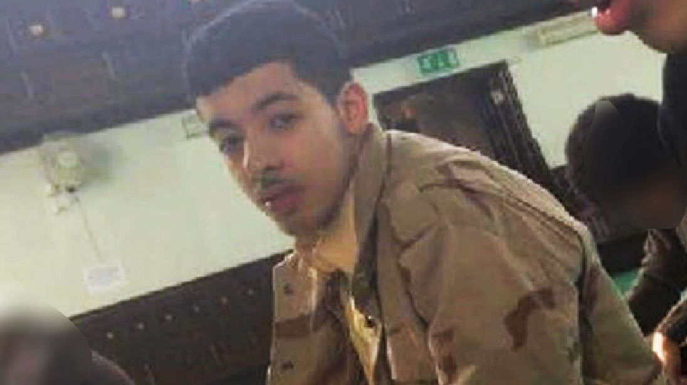
What does a terrorist look like?
ALL TERRORISTS
Notes:
Ask students to consider what they think a terrorist ‘looks’ like. They will be influenced by the medias portrayal of a terrorist.

Slide 19
We are all familiar with what the media tells us a terrorist looks like but we know that anyone can become a radicalised and become a terrorist.
A terrorist does not have a particular appearance. A terrorist can belong to any gender, race or religious belief and can dress and wear their hair however they choose.

Slide 20
Terror attacks
NAME: Anders Breivik, NORWAY
ORGANISATION: Norweigian far-right terrorist
TARGET: Killed 8 people in a bomb attack before shooting dead 69 young people at a Summer Camp for the Norweigian Labour Party
PUNISHMENT: 21 years detention
Notes:
go to www.youtube.com and search for ‘BBC Who is Norway shooting suspect Anders Behring Breivik’

Slide 21
Terror attacks
NAME: RICHARD REID, “THE SHOE BOMBER”, UK
ORGANISATION: AL QAEDA
TARGET: AMERICAN AIRLINES FLIGHT 63
PUNISHMENT: 110years detention WITH NO PAROLE
Notes:
search for ‘Shoebomber Richard Reid December 22, 2001 Boston’

Slide 22
Terror attacks
NAME: THOMAS “SLAB” MURPHY
ORGANISATION: IRISH REPUBLICAN ARMY OR IRA
TARGET: ACCUSED OF DIRECTING IRA BOMBING CAMPAIGNS IN THE UK
PUNISHMENT: assets seized, never imprisoned
Notes:
Arrests/charges against Thomas ‘Slab’ Murphy have been subject to libel claims.

Slide 23
Terror attacks
NAME: Salman Abedi
ORGANISATION:
TARGET: 22 Dead at Manchester Concert, women and young children mainly in the arena.
https://www.youtube.com/watch?v=9HvNvH14BGA
Notes:
’

Slide 24
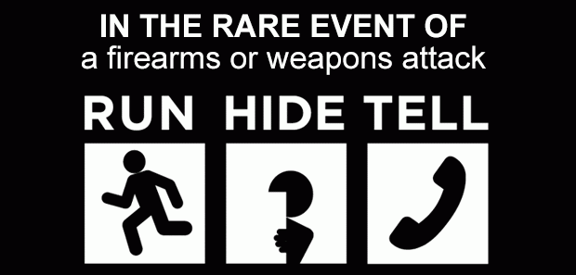
Run, Hide, Tell: Advice For Young People
https://www.youtube.com/watch?v=s3y51Vd4kJ4

Slide 25
What factors might‘push/pull’ someone towards an extremist organisation?
Not feeling part of society – ‘no one listens, no one understands’
Feeling like I don’t have a say - ‘Nothing ever changes’
Lack of social skills / difficulties with mixing with other communities - ‘They’re not like us’
Grievances – real or perceived - things I am concerned about’
Unemployment
Global events
Media biases
Unable to reflect upon or challenge propaganda

Slide 26
Pull Factors-What factors might ‘pull’ someone towards an extremist organisation?
Group offers sense of belonging, community, friendship, acceptance.
Clear identity and purpose.
Similar to gang cultures.
They offer an outlet for frustrations and grievances.
Opportunity to express emotions, including anger.
Gain status which may be lacking elsewhere.
e.g. IT experts who become hacktivists.
Senior activists represent parental figures and parental substitutes.
There are lots of signs to warn us about radicalisation, extremism and terrorism but often the act has been committed before anyone realises. Therefore It can be hard to prevent terrorism.

Slide 27
Watch the video
https://www.truetube.co.uk/film/extremists%3Ftab%3Dteachers_notes
Notes:
Video Discussion handout questions provided

Slide 28
Where to go for help
Speak to a member of college staff.
The college Safeguarding Officers: Liz Ward, Kerry Reeve, Nicola Martin
Your tutor.
Speak to a family member or friend.

