Slide 1
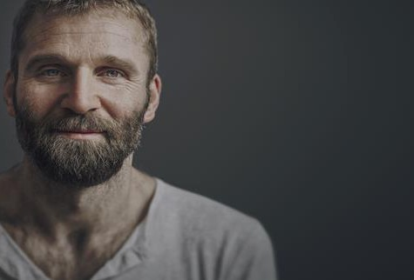

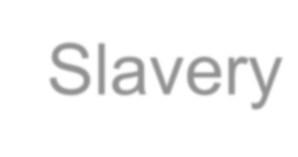


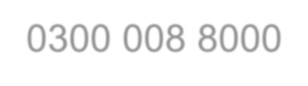

Responding to Modern Slavery
Nigel Oseman ~ Training & Investigation 0300 008 8000
www.hopeforjustice.org

Slide 2


Explain what modern slavery and human trafficking are.
Recognise the signs and indicators.
Understand how to respond appropriately to a victim of modern slavery.

Slide 3

… to live in a World Free from Slavery
We exist to bring an end to modern slavery by preventing exploitation, rescuing victims, restoring lives and reforming society.
Notes:
Hope for justice’s aim

Slide 4
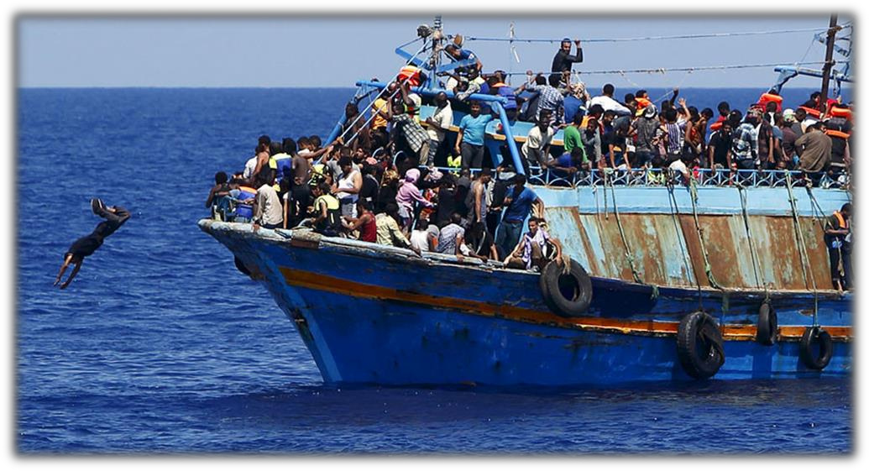
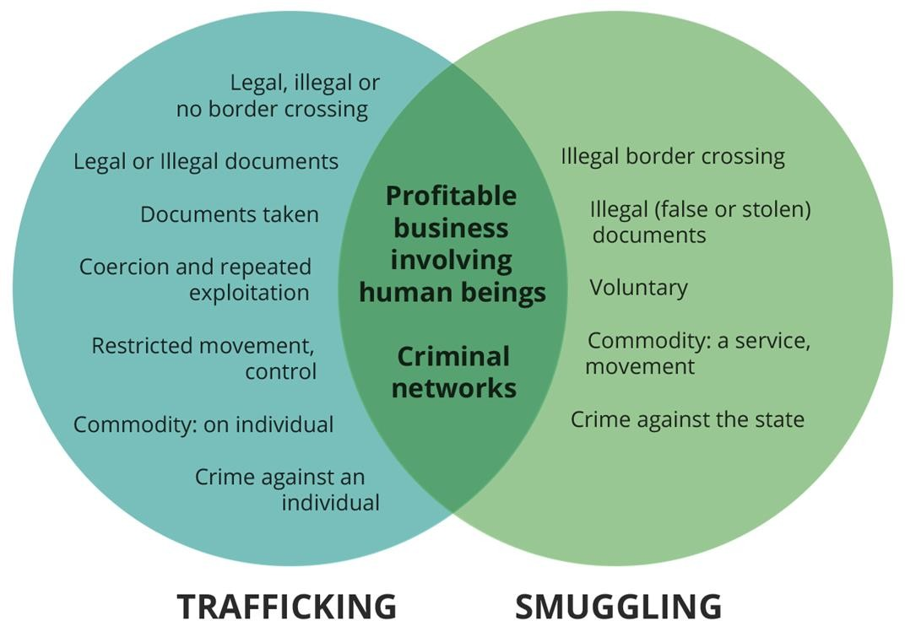

Human Trafficking v People Smuggling
Notes:
Discuss the difference between trafficking and smuggling

Slide 5
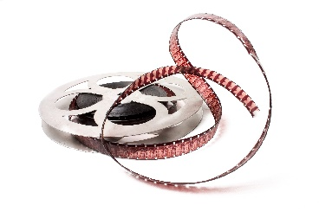
..to live in a world free from slavery..
Modern slavery and human trafficking - it's closer than you think!
Notes:
Click on the arrows to show the short videos

Slide 6
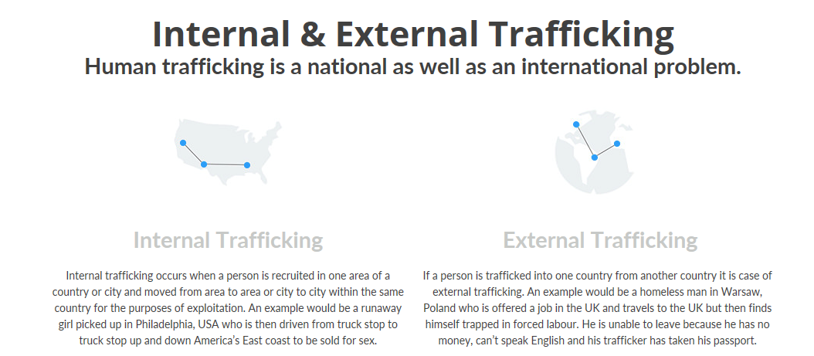
Notes:
Explain the link between trafficking and modern slavery and how trafficking can be internal

Slide 7
Using your mini wipe boards name as many general indicators as possible in 5 minutes…

Slide 8
Mini white board list: General indicators
Trafficking victims are often lured into another country by false promises and so may not easily trust others.
They may:
Be fearful of police/authorities
Be fearful of the trafficker, believing their lives or family members’ lives are at risk if they escape
Exhibit signs of physical and psychological trauma e.g. anxiety, lack of memory of recent events, bruising,
untreated conditions
Be fearful of telling others about their situation
Be unaware they have been trafficked and believe they are simply in a bad job
Have limited freedom of movement
Be unpaid or paid very little
Have limited access to medical care
Seem to be in debt to someone
Have no passport or mention that someone else is holding their passport
Be regularly moved to avoid detection
Be controlled by use of witchcraft e.g. Ju Ju
Notes:
Ask the students to get into groups and create a list of indicators before showing them the slide. They can tick off ones they have. Alternatively, play last man standing before showing them the slide.

Slide 9
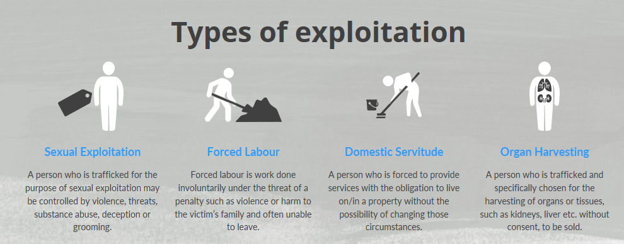
Notes:
Ask students to identify the different types of modern slavery before revelling the slide. Also explain that there is actually a 5th = criminal activity. Give the eg of cannabis factories (rather than Oliver Twist – although organised pickpocketing and shoplifting is still a thing!) Spend some time discussing county lines, cuckooing and identifying factors/what to do.

Slide 10
County lines:
Gangs and organised criminal networks involved in exporting illegal drugs into other areas of the country by exploited children or vulnerable adults..
How do gangs get children and adults to work for them?
Through grooming, violence (often sexual violence) and payment. This may be cash, drugs, clothes or even protection, status, affection or perceived friendship.

Slide 11
Cuckooing:
Cuckooing is a form of county lines crime in which drug dealers take over the home of a vulnerable person in order to criminally exploit them as a base for drug dealing, often in multi-occupancy or social housing properties.

Slide 12
County lines: who is at risk
Any child, young person or vulnerable person could be at risk of being criminally exploited by drugs or organised crime gangs. However, some are more vulnerable including those who are:
Experiencing domestic violence, parental drug abuse or criminality
Have an unstable home life
Are excluded from school and suffering social isolation
Suffering homelessness or living in insecure accommodation
Have learning or physical disabilities and/or mental health issues
Have associations with criminality or being in care
Notes:
Ask the students to get into groups and create a list of indicators before showing them the slide. They can tick off ones they have. Alternatively, play last man standing before showing them the slide.

Slide 13
County lines: what are the signs
County lines
Cuckooing
Gang association or isolation from peers or social networks
Missing from home or schools and/or significant decline in performance
New friends or relationships with those who don't share any mutual friendships with the victim or anyone else
May be carrying a weapon
Receiving more texts or calls than usual
Sudden influx of cash, clothes or mobile phones
Unexplained injuries
Significant changes in emotional well-being
Increase in anti-social behaviour
A neighbour who hasn't been seen for an extended period
Increase in people entering or leaving or an increase in cars or bikes outside a home
Signs of drug use
Windows covered or curtains closed for a long period
Notes:
Get half the room to discuss county lines and the other half to look for signs of cuckooing – before showing them the slide.

Slide 14
County lines: how to help
Make a report
If you believe you may be a victim (or think somebody may be a victim) of exploitation through county lines or cuckooing, we advise you to contact one of the following:
Leicestershire Police
Email: contactus@leicestershire.pnn.police.uk
Social media: Private message us on Facebook or Twitter
Phone: 101
Leicester City Council
Child/Teenager
Phone: 0116 454 1004 (24hrs)
Leicestershire County Council
Child/Teenager
Online: Online form
Phone: 0116 305 0005 (24hrs a day)
Notes:
.Also tell them to speak to Liz, Nicola, Sam, Su or yourself.

Slide 15
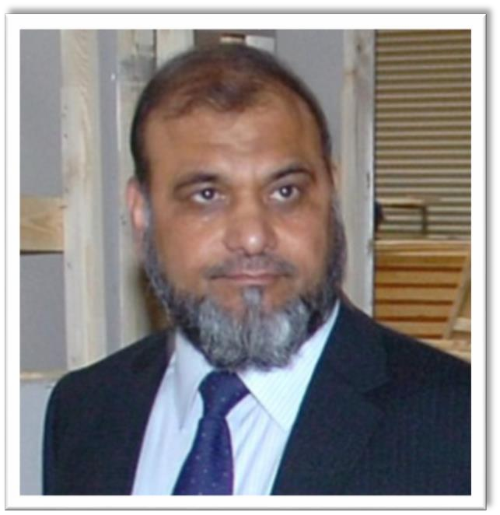
Forced Labour Case Study
Business owner Mohammad Rafiq, supplier of Kozee Sleep mattresses to companies including John Lewis, Dunelm Mill and Next plc.
When accused of modern slavery, he claimed his innocence, stating that he was unaware of the workers pay and living conditions.
Notes:
Q: Does he look respectable ……

Slide 16

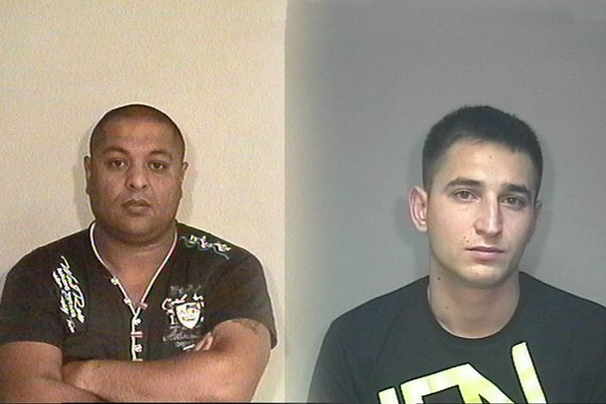
The Hungarian workers were housed in inhumane conditions by these two men.
Migrants were piled high into flats and houses. There were 14 sharing one bathroom and one toilet. All cooking was done in one pot.
One victim stated “ They said they knew where my family lived and they could get hold of them”.
They were charge with conspiracy to traffick.
Janos Orsos (left) and Ferenc Illes were jailed for five years and three years.

Slide 17
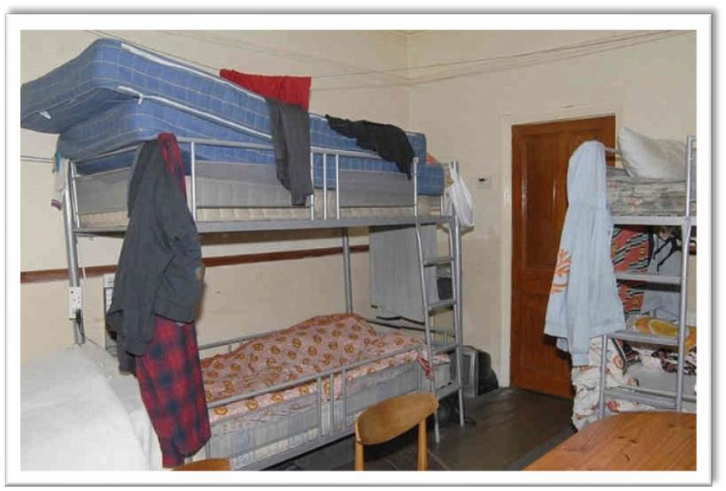
One of the Hungarian victims said he said he felt “helpless” and “vulnerable” and like a prisoner during his time at the bed-making firm.
They were promised up to £1000 a month – they earned less than £2 a day
After a major police operation, Mohammed Rafiq, the 60 year old owner of Kozee Sleep, became the first company boss to be convicted of human trafficking and running a sweat shop.
Notes:
One of the deciding factors in the case was that Rafiq also owned the properties that were being used to ‘house’ the victims.

Slide 18
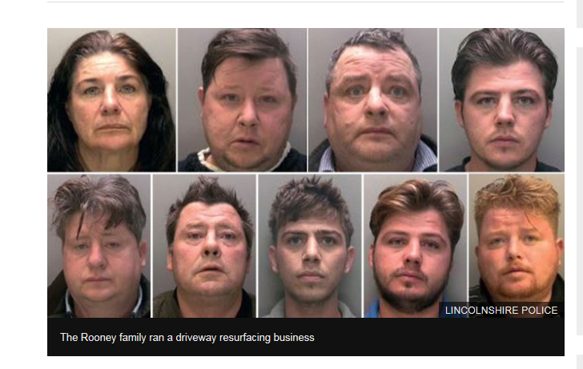
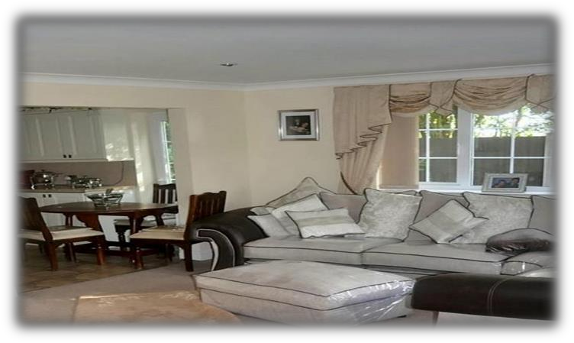
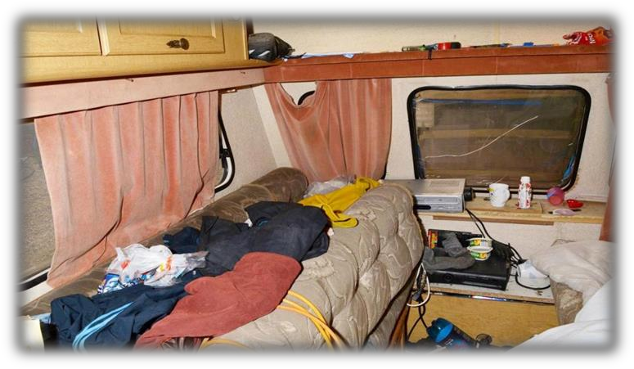
The Rooney family
One victim, whose ordeal spanned more than 25 years, was made to dig his own grave.
Victims were beaten and left with no water or toilet facilities. They lived in squalor whilst the Rooney's lived in relative luxury
Martin Rooney Senior was jailed for 10 years, while two of his sons were each jailed for more than 15 years.
Notes:
Large traveller family from Lincoln, already known to the police for bare knuckle fighting etc. Kept vulnerable homeless adults for forced labour – block paving etc. Discuss the indicators of forced labour – how would you know if the person doing your drive was a modern slave?

Slide 19
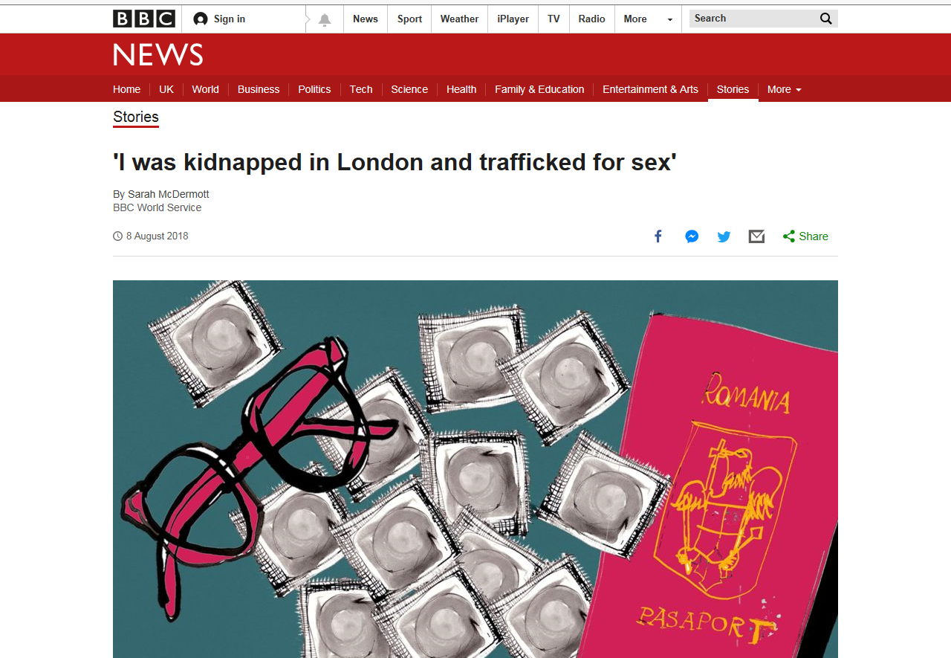
Notes:
Edit the word document to differentiate for your group. Students need to read the article and then in small groups discuss why she was targeted and how her captures managed to keep her in slavery. Discuss ‘from injustice comes justice’ and discuss Lord Morrow and the 2015 act.

Slide 20


Main provision:
Consolidate existing offenses
Increase the maximise sentence to life imprisonment.
Introduce statutory defence for victims
Creates an independent Anti-Slavery Commissioner
New obligations for large organisations (statement)
Introduces Slavery and Trafficking Prevention and Risk orders
Notes:
Students don’t need to know these especially – the main point is for them to understand that this is a crime and will be dealt with by the justice system as a crime!

Slide 21





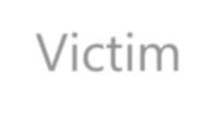



















Perpetrator
Consumer
Victim
Unconsciously contributing
Know your sources, reduce the risk, understand your slavery footprint
Be transparent about supply chains
Men, women and children of all ethnicities and nationalities, cutting across populations
More prevalent amongst vulnerable groups, those in minority or socially excluded groups
Organised criminal gangs
Worlds fastest growing crimes
Second largest source of illegal income
Notes:
Discuss what they know about each. Ref carwash app in relation to consumer

Slide 22

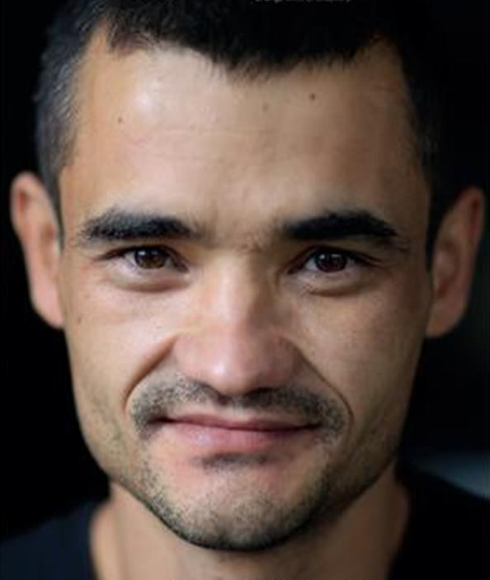




Of the victims of modern slavery that entered the UK in 2017, how many countries do you think were involved?
84
116
49
197
Answer: 116
Notes:
Question: how many countries are there (195)

Slide 23

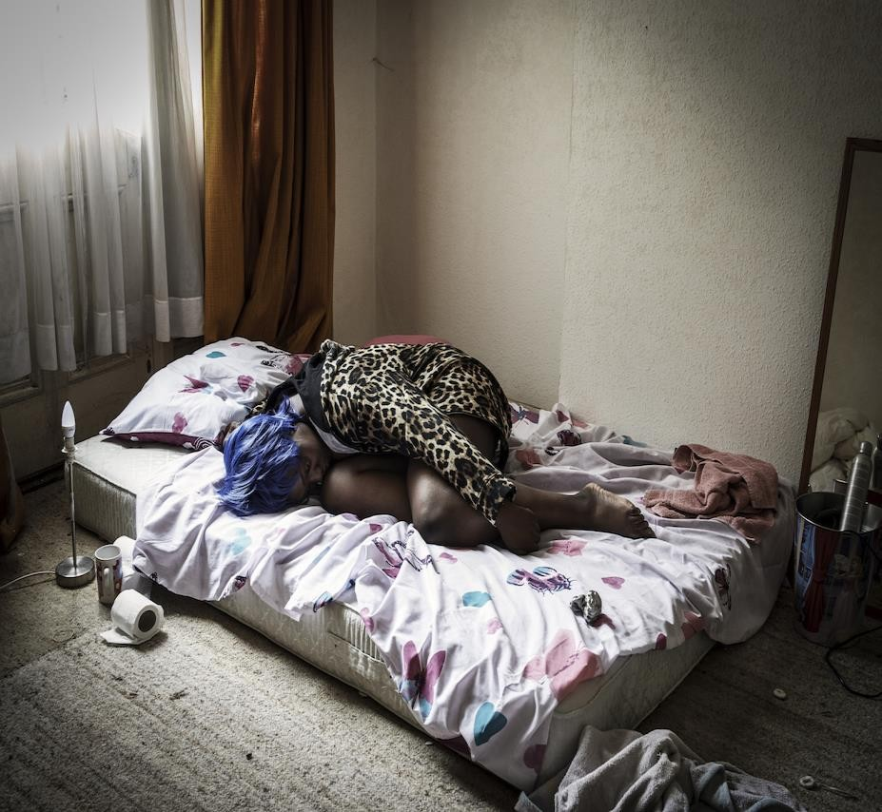

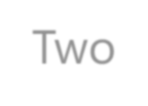

During 2017, which country do you think most victims originated from?
Nigeria
United Kingdom
Vietnam
Albania
Answer: United Kingdom
Notes:
2016 it was Albania

Slide 24
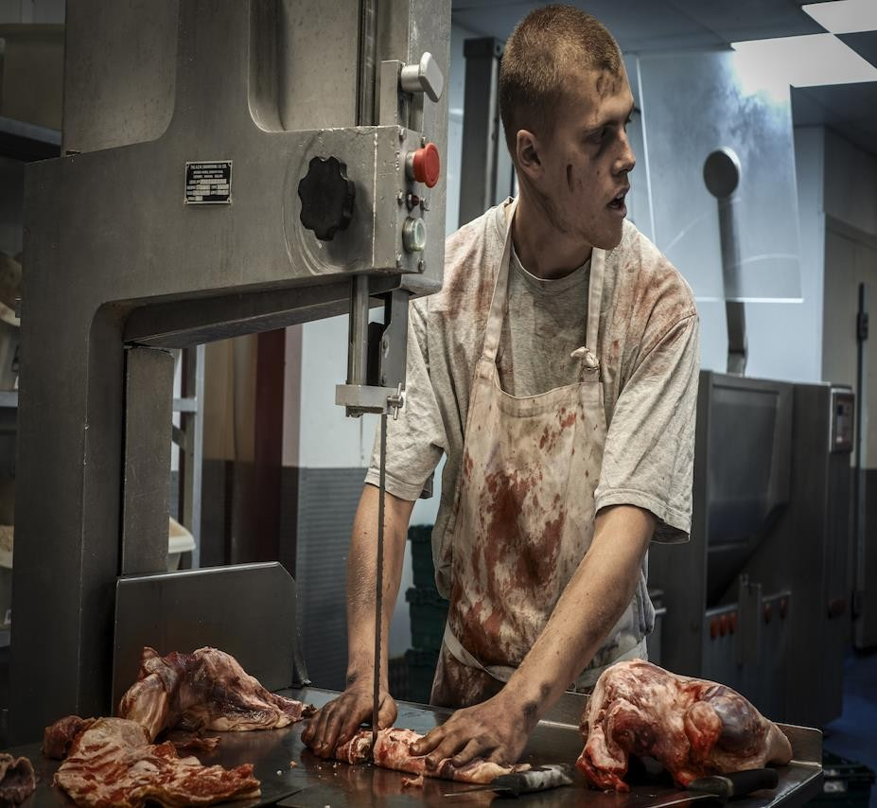



Of these victims, which do you think is the most common form of exploitation?
Forced labour
Sexual exploitation
Domestic servitude
Organ harvesting
Answer: Forced labour
Notes:
Sexual exploitation is a close second. Organ harvesting – ref people sell their own organs, but that is separate from modern slavery where there is no choice – this is fairly uncommon in the UK

Slide 25
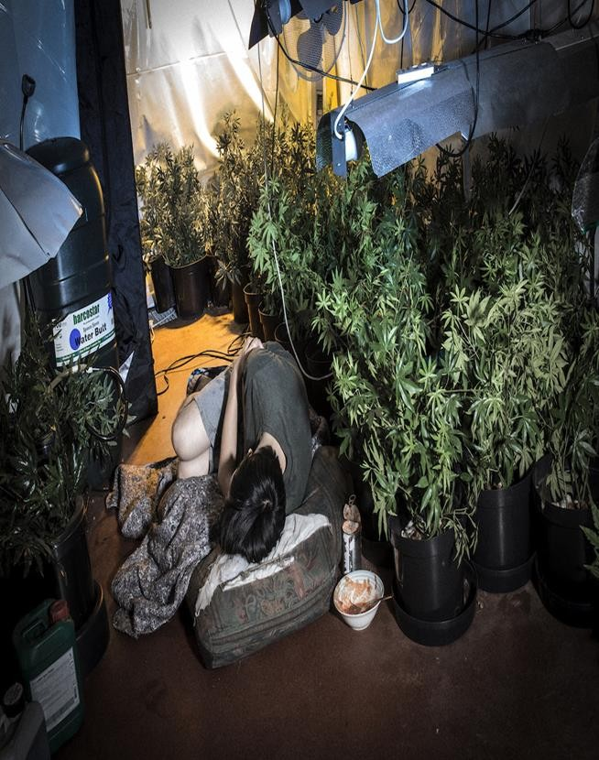

Were there more males or females trafficked during 2017?
Males
Females
Answer: Males
2668 males 2454 females 3 transgender

Slide 26
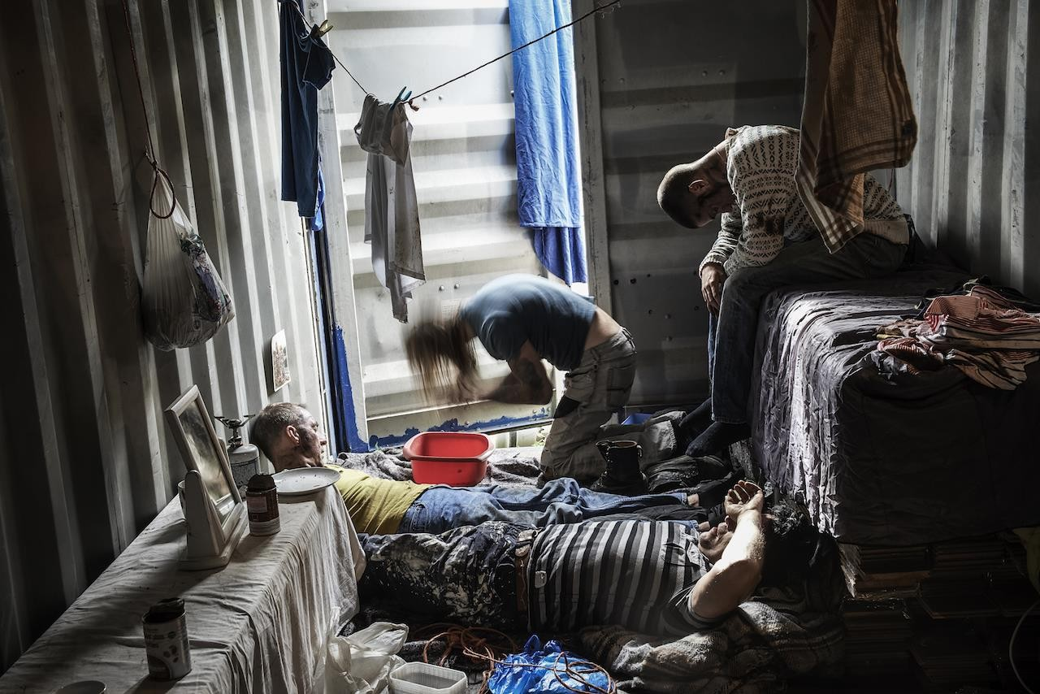


What do the letters NRM stand for?
National Refugee Measures
National Referral Mechanism
Nationwide Refugee Monitoring
National Referral Measures
Answer: National Referral Mechanism

Slide 27
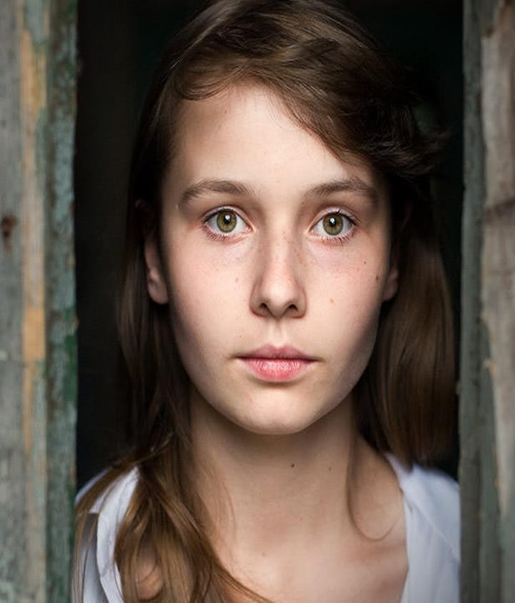


Currently, around the world, how many people are believed to be in a position of modern slavery?
a) 12-15 million
b) 300,000 – 500,000
c) 120 – 200 million
d) 25 – 40 million
Answer: 25 – 40 million

Slide 28
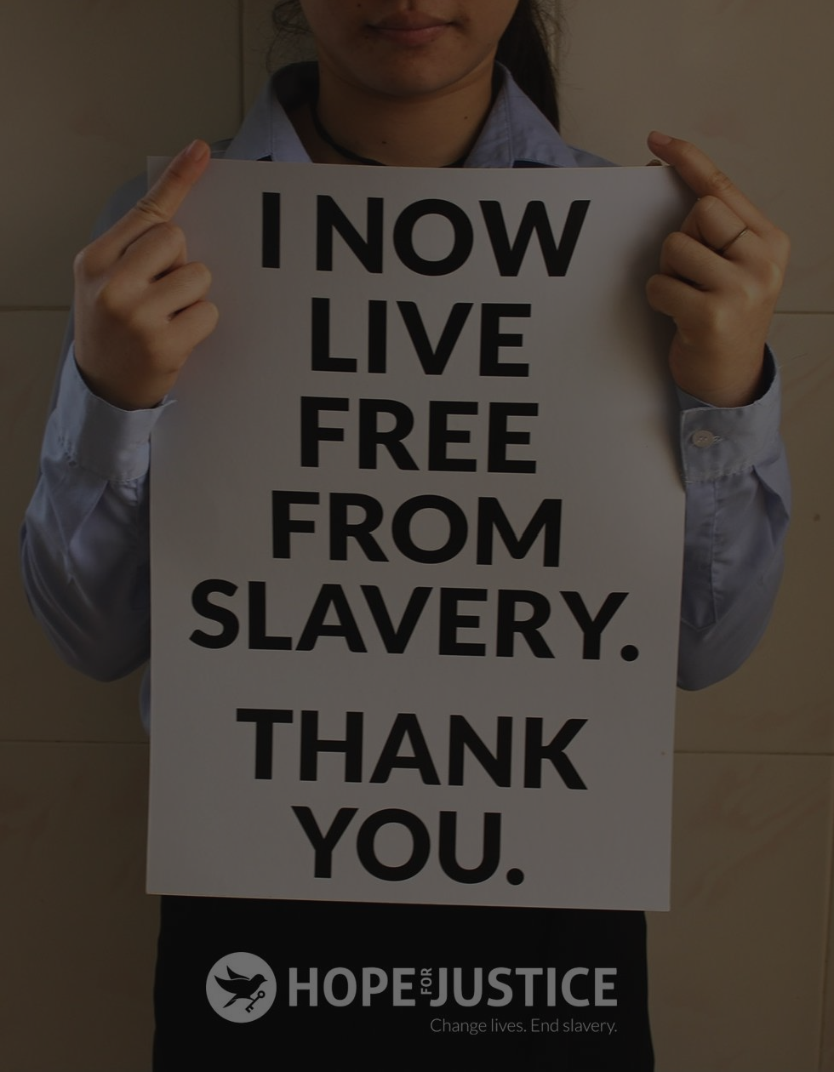


World wide, what is the average cost to buy a slave?
£1000
£30,000
£500
£ 60
Answer: £60

Slide 29
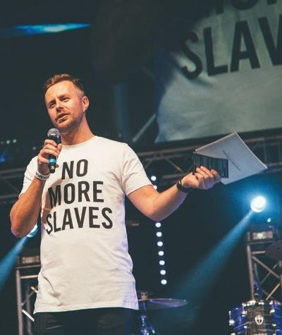



Which of these need to of happened for human trafficking to take place?
Crossing an international boarder
Moving from one country to another
Moving from one hotel room to another
Being moved from one town to another
Answer: all four are correct
Notes:
Discuss the use of airb&b for pop up brothels, crossing county lines for drugs deals (use of modern slaves for criminal activities)

Slide 30

What can you do?
Report any concerns or suspicions you have to the police or The Modern Slavery helpline 0800 0121 700, is open 24 hours a day. If you think a child is in danger of trafficking you can contact the NSPCC's helpline 0808 8005 000.
Don’t be a consumer
Join in with the fundraising events in college

