Slide 1
MENTAL HEALTH AND WELLBEING
LO: TO DEFINE MENTAL HEALTH
TO IDENTIFY ISSUES WITH STIGMA
TO IDENTIFY YOUR STRESS TRIGGERS AND COPING STRATEGIES

Slide 2
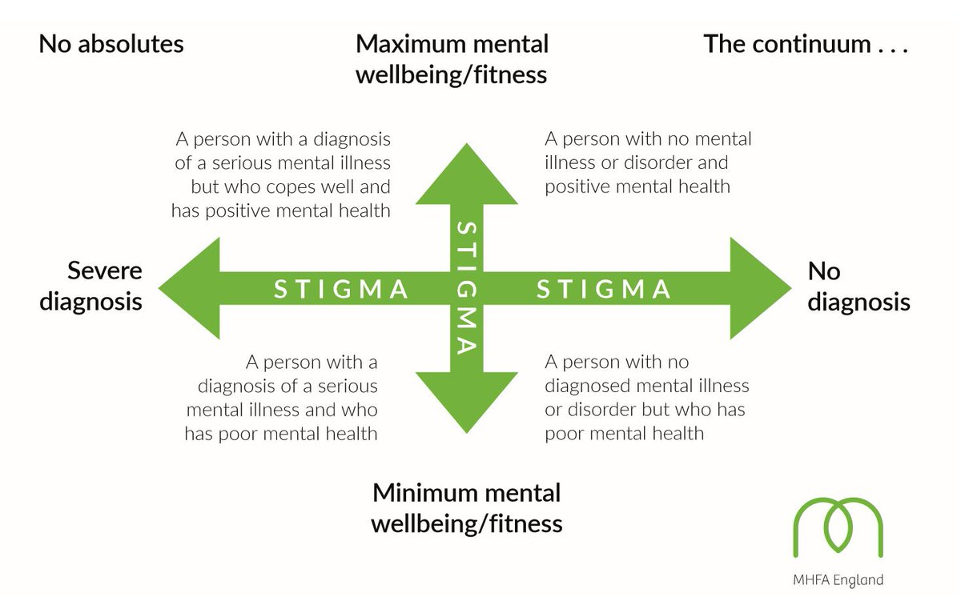

Slide 3

Quadrant 1: Write down how you think someone with positive mental health would think, feel and behave.
Quadrant 2: Write down how you think someone with poor mental health would think, feel and behave.

Slide 4
EXPERIENCING STIGMA
Listen to the case study then answer:
How would you feel if this happened to you?
How might this affect your relationships at home and at college?
How would this affect your future decisions to tell people about being ill?
Would you feel different if this scenario had been about mental health?
What could the people in the scenario have done differently to help?

Slide 5
Stress container: what’s in yours?
Add your stressors to
your container
2. Write down your coping strategies
3.Write down your stress signature

Slide 6
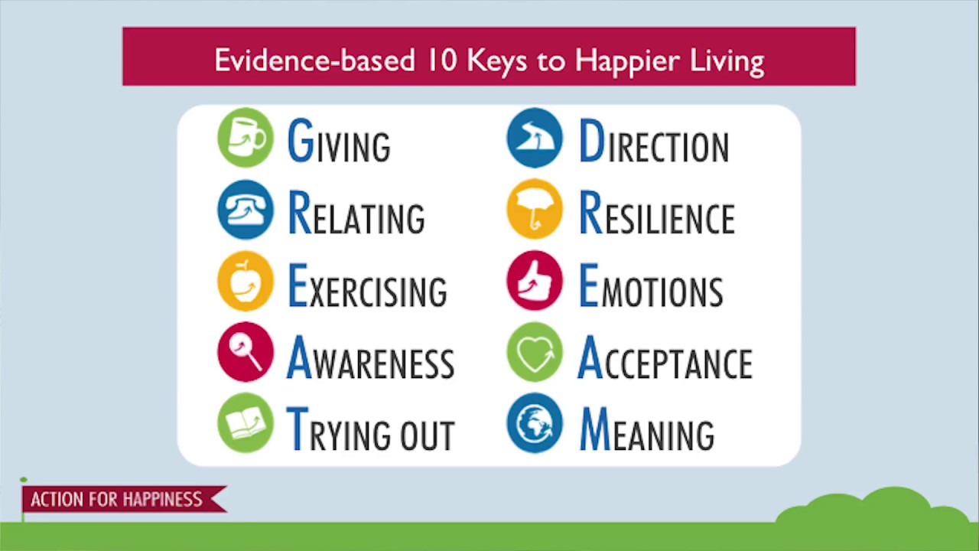
Notes:
https://www.youtube.com/watch?v=WuyPuH9ojCE
https://www.youtube.com/watch?v=gmwiJ6ghLIM

Slide 7
Mental Health conditions quiz
The average episode of depression lasts 6-8 months
True/False
2. The three cores symptoms needed for a diagnosis of depression are: sad mood that wont go away, lack of energy and tiredness, difficulty sleeping.
True/False
3. Anxiety is always unhelpful.
True/False
4. Anxiety can cause physical symptoms: rapid heart rate, muscle tension, sweating, sleep disturbance, nausea, chest pain, shallow breathing, fainting,
True/False
5. Eating disorders are a diet gone wrong – they are all about food and weight.
True/False

Slide 8
Mental Health conditions quiz
The average episode of depression lasts 6-8 months
True
2. The three cores symptoms needed for a diagnosis of depression are: sad mood that wont go away, lack of energy and tiredness, difficulty sleeping.
False (the last one should be loss of enjoyment of previously enjoyable activities)
3. Anxiety is always unhelpful.
False (anxiety is a natural response to help avoid danger)
4. Anxiety can cause physical symptoms: rapid heart rate, muscle tension, sweating, sleep disturbance, nausea, chest pain, shallow breathing, fainting,
True
5. Eating disorders are a diet gone wrong – they are all about food and weight.
False (it is usually an attempt to deal with underlying emotional distress)

Slide 9
Looking out for each other
Case study questions

Slide 10
If I’m not coping- where can I go?
Gateway College | COMMUNITY | WEB
Tutor | Friends | www.mindfull.org
SLT (Nicola Martin) | Family | www.youngminds.org.uk
Safe Guarding Lead (Liz Ward) | Self- help guides | www.youth2youth.co.uk
Head of School (Sam Keen, Su Peters) | Telephone help lines | www.mind.org.uk
PCO (Jimmy Rana, Marcus Benjamin, Mo Ahmed) | Community groups | www.actionforhappiness.org

